Slide 1



Cloud Pricing Models
A comparison of AWS, Azure and GCP
Marcel Dietl

Slide 2
Comparison of Main Cloud Price Model Options
On-demand Pay only for the instances used with no long-term commitments or upfront payments. | Savings Plans Reduce costs by making a commitment to a consistent amount of usage (in USD / h) for a term of 1 or 3 years. | Reserved Instances Reduce costs by making a commitment to a specific instance configuration for a term of 1 or 3 years. | Spot Instances Spot instances allow to request spare computing capacity for a significant discount off the On-Demand prices. | Other options Further reduction of costs for specific use cases.
Per second billing Minimum of 60s | Up to 66% discount | Up to 72% discount Volume discounts Marketplace available | Up to 90% discount Eviction notice time: 120s Stop, Hibernate, Terminate (default) Options Stop and Hibernate allow to resume work | Dedicated Hosts: Physical EC2 server dedicated for your use and allowing you to use your existing server-bound software licenses.
Per second billing | Up to 65% discount Up-front payment or monthly Every usage above commitment is charged with on-demand prices | Up to 72% discount Cancelation possible for a termination fee | Up to 90% discount Eviction notice time: 30s Deallocate (default) or delete options Deallocate sets the instance to a stopped state to restart it later, but incurs storage costs | Azure Hybrid benefit: Lets existing on-premises licenses apply towards Azure services, resulting in significant cost savings.
Per second billing Minimum of 60s | Compute Engine flexible committed use discounts 28% on 1 year 46% on 3 years | Resource-based committed use discounts 37% on 1 year 57% on 3 years, 70% if it is a memory optimized machine | Between 60% and 91% discount Eviction notice time: 30s Terminate (default) and delete options Able to resume work, but charged storage costs for underlying disks | Sustained Use discounts: When CPU or memory is used 25% or more per month, discount is granted for every additional hour and can get up to 30%

Slide 3
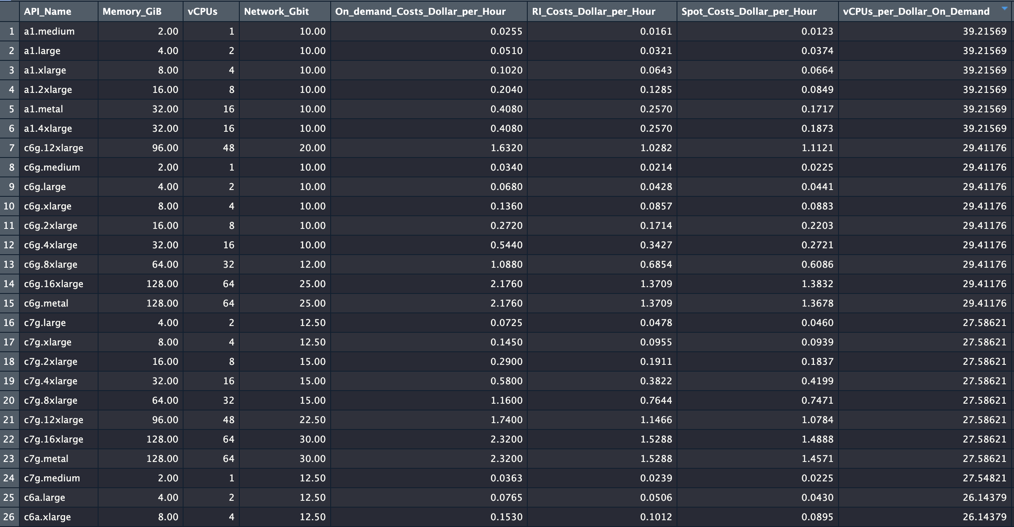
Approach for Analyzing Instances and Prices
Example for AWS Data:
Exporting data from https://instances.vantage.sh
Trimming the data and keeping only relevant information
Calculating per dollar ratios for better comparability (vCPUs/$, GiB/$, Gbps/$)
Identifying the best instance type according to vCPUs/$ ratio

Slide 4
Comparison of Cloud Instance Types and On-demand Prices
General Purpose General purpose machine types with balanced CPU, memory and storage. Applicable for web apps or small to medium databases. | Compute Optimized Ultra high performance for compute-intensive workloads like HPC, AI/ML or compute-bound workloads. | Memory Optimized Ultra high memory performance workloads like medium to high OLAP or in-memory databases. | Benchmark Instances with the best vCPU to dollar ratio.
m6g Series (e.g. m6g.4xlarge) Processor: 64-bit-ARM-Neoverse (AWS Graviton2) ca. 26 vCPUs/$ ca. 104 GiB/$ ca. 16 Gbps/$ Also available with Intel und AMD processors. | c6g Series (e.g. c6g.4xlarge) Processor: 64-bit-ARM-Neoverse (AWS Graviton2) ca. 29 vCPUs/$ ca. 59 GiB/$ ca. 18 Gbps/$ Also available with Intel und AMD processors. | r6g Series (e.g. r6g.4xlarge) Processor: 64-bit-ARM-Neoverse (AWS Graviton2) ca. 20 vCPUs/$ ca. 159 GiB/$ ca. 12 Gbps/$ Also available with Intel und AMD processors. | a1 series (e.g. a1.4xlarge) Processor: 64-bit-ARM-Neoverse (AWS Graviton) ca. 39 vCPUs/$ ca. 78 GiB/$ ca. 25 Gbps/$ Not available with any other specifications.
D Series (e.g. D16 v3) Processor: 2.3 GHz Intel® XEON ® E5-2673 v4 (Broadwell) ca. 21 vCPUs/$ ca. 83 GiB/$ ca. 10 Gbps/$ Also available with ARM and AMD processors. | F Series (e.g. F16s v2) Processor: 2.7 GHz Intel Xeon® Platinum 8168 (SkyLake) ca. 24 vCPUs/$ ca. 47 GiB/$ ca. 10 Gbps/$ Only available with other Intel specifications. | M Series (e.g. M32ts) Processor: Intel® Xeon® E7-8890 v3 2.5GHz (Haswell) ca. 12 vCPUs/$ ca. 71 GiB/$ ca. 3 Gbps/$ Also available with the Intel® Xeon® Platinum 8280M (Cascade Lake). | HB Series (e.g. HB60rs) Processor: AMD EPYC 7551 ca. 26 vCPUs/$ ca. 105 GiB/$ - Gbps/$ Not available with any other specifications.
N2D Series (e.g. n2d-highcpu-16) Processor: 2 gen. AMD EPYC Rome ca. 32 vCPUs/$ ca. 32 GiB/$ ca. 64 Gbps/$ Also available with 3 gen. AMD EPYC Milan processor. | C2D Series (e.g. c2d-highcpu-16) Processor: 3 gen. AMD EPYC Milan ca. 27 vCPUs/$ ca. 53 GiB/$ ca. 53 Gbps/$ C2 Series is available on an Intel Scalable Processor (Cascade Lake) processor. | M2 Series (e.g. m2-megamem-416) Processor: Intel Cascade Lake ca. 9 vCPUs/$ ca. 132 GiB/$ ca. 0.7 Gbps/$ Not available with any other specifications. | E2 Series (e.g. e2-highcpu-16) Processor: 2 gen. AMD EPYC Rome ca. 40 vCPUs/$ ca. 40 GiB/$ ca. 40 Gbps/$ Also available with Intel processors.
Instances with 64 GiB and 16 vCPUs / 64 GiB and 16 vCPUs / 16 GiB and 16 vCPUs
Instances with 32 GiB and 16 vCPUs / 32 GiB and 16 vCPUs / 32 GiB and 16 vCPUs
Instances with 128 GiB and 16 vCPUs / 192 GiB and 32 vCPUs / 5888 GiB and 416 vCPUs
Instances with 32 GiB and 16 vCPUs / 240 GiB and 60 vCPUs / 16 GiB and 16 vCPUs

Slide 5
All prices for exemplary instances with 16 vCPUs and 32 GiB memory
On-demand | Savings Plans* | Reserved Instances* | Spot Instances
Actual Price 0.54 $/h Resources per Dollar ca. 29 vCPUs/$ ca. 59 GiB/$ ca. 18 Gbps/$ | Actual Price 0.40 $/h Resources per Dollar ca. 40 vCPUs/$ ca. 80 GiB/$ ca. 25 Gbps/$ | Actual Price 0.34 $/h Resources per Dollar ca. 47 vCPUs/$ ca. 93 GiB/$ ca. 29 Gbps/$ | Actual Price (from AWS Website) 0.16 $/h Resources per Dollar ca. 100 vCPUs/$ ca. 200 GiB/$ ca. 63 Gbps/$
Actual Price 0.68 $/h Resources per Dollar ca. 24 vCPUs/$ ca. 47 GiB/$ ca. 10 Gbps/$ | Actual Price 0.46 $/h Resources per Dollar ca. 35 vCPUs/$ ca. 70 GiB/$ ca. 15 Gbps/$ | Actual Price 0.40 $/h Resources per Dollar ca. 40 vCPUs/$ ca. 80 GiB/$ ca. 18 Gbps/$ | Actual Price (from Microsoft Website) 0.12 $/h Resources per Dollar ca. 133 vCPUs/$ ca. 267 GiB/$ ca. 58 Gbps/$
Actual Price 0.68 $/h Resources per Dollar ca. 24 vCPUs/$ ca. 47 GiB/$ ca. 47 Gbps/$ | Actual Price 0.31 $/h** Resources per Dollar ca. 52 vCPUs/$ ca. 103 GiB/$ ca. 103 Gbps/$ | Actual Price 0.31 $/h** Resources per Dollar ca. 52 vCPUs/$ ca. 103 GiB/$ ca. 103 Gbps/$ | Actual Price (from GCP Website) 0.16 $/h Resources per Dollar ca. 100 vCPUs/$ ca. 200 GiB/$ ca. 200 Gbps/$
c6g.4xlarge
F16s v2
c2d-highcpu-16
*Savings Plans prices for 1 year plans
*Reserved Instances prices for 1 year plans
**GCP does not list different prices for Ris and Savings Plans

Slide 6

Identification of Relevant Parameters for an Algorithm
Input = Requirements
Output = Price optimal instance choice
Inputs:
Amount of vCPUs
GiB Memory
Gbps of network performance
Type of workload (e.g. is consistent availablity necessary? Fault tolerant?)
Amount of time the instance is required
Algorithm:
Take given parameters as Inputs
Have access to the current prices for every given instance incl. Spot
Know the prerequisites for the discounts to apply (e.g. minimum of 1 year)
Decide on how to identify the best instance (e.g. by vCPUs, memory or costs of a specific workload)
Output:
Which instance is price optimal in which pricing option based on the entered parameter specifications.

Slide 7
Notizen zum Brainstorming
Input:
Workload in vCPU Stunden (z.B. 240 vCPU Stunden pro Tag = min. 10 vCPU in der Stunde bei 10 Prozessorkernen)
Annahmen:
Es gibt einen Base Workload der immer gedeckt sein muss (geht nicht mit Spot, nur mit RI oder Savings)
Zusätzlich gibt es einen schwankenden Workload (je nach Zeit (z.B. Weihnachten) oder Unternehmensart -> erstmal nicht wichtig) der dann entweder am Maximum durch RI/Savings gedeckt sein muss oder durch Spot Instances
Bei Spot ist zu modellieren was die Wahrscheinlichkeit ist die Instanz zu verlieren und auf die nächst schlechtere zu gehen
Es wird angenommen, dass die Instanzen für längere Zeit gebraucht werden, d.h. RI und Savings sind anwendbar
Wichtig zu wissen, ob SP erweitert werden können und an den benötigten Workload angepasst werden können
Alles wird modelliert mit angenommenem Wachstum: w(x) = f(x) * 1,05^Jahre
Es ist nur wichtig, dass die Anzahl der vCPUs den benötigten Workload z.B. pro Tag erfüllen können, sonst macht es für den Preis pro vCPU nichts aus welche man nimmt, da die Preise proportional zu vCPUs steigen (außer bei Spot) -> für insgesamten Preis schon
Output:
Mix aus Instanzen und Preisoptionen
Recherche:
Kann man Savings Plans zwischendrinnen upgraden wenn man doch mehr braucht?
Kann man SP canceln? Oder nur RIs?
Was sind die Interuption Rates für Spot? -> gibt auch Tabellen über die letzten 30 Tage pro Instanz
Vorgehen:
Erstmal den Base Case modellieren -> billigste Option finden
Danach brute force alle Möglichkeiten durchprobieren und die billigste nehmen
Evtl. erstmal mit ein paar Instanzen anfangen zur leichteren Übersicht
In Graphen modellieren

Slide 8
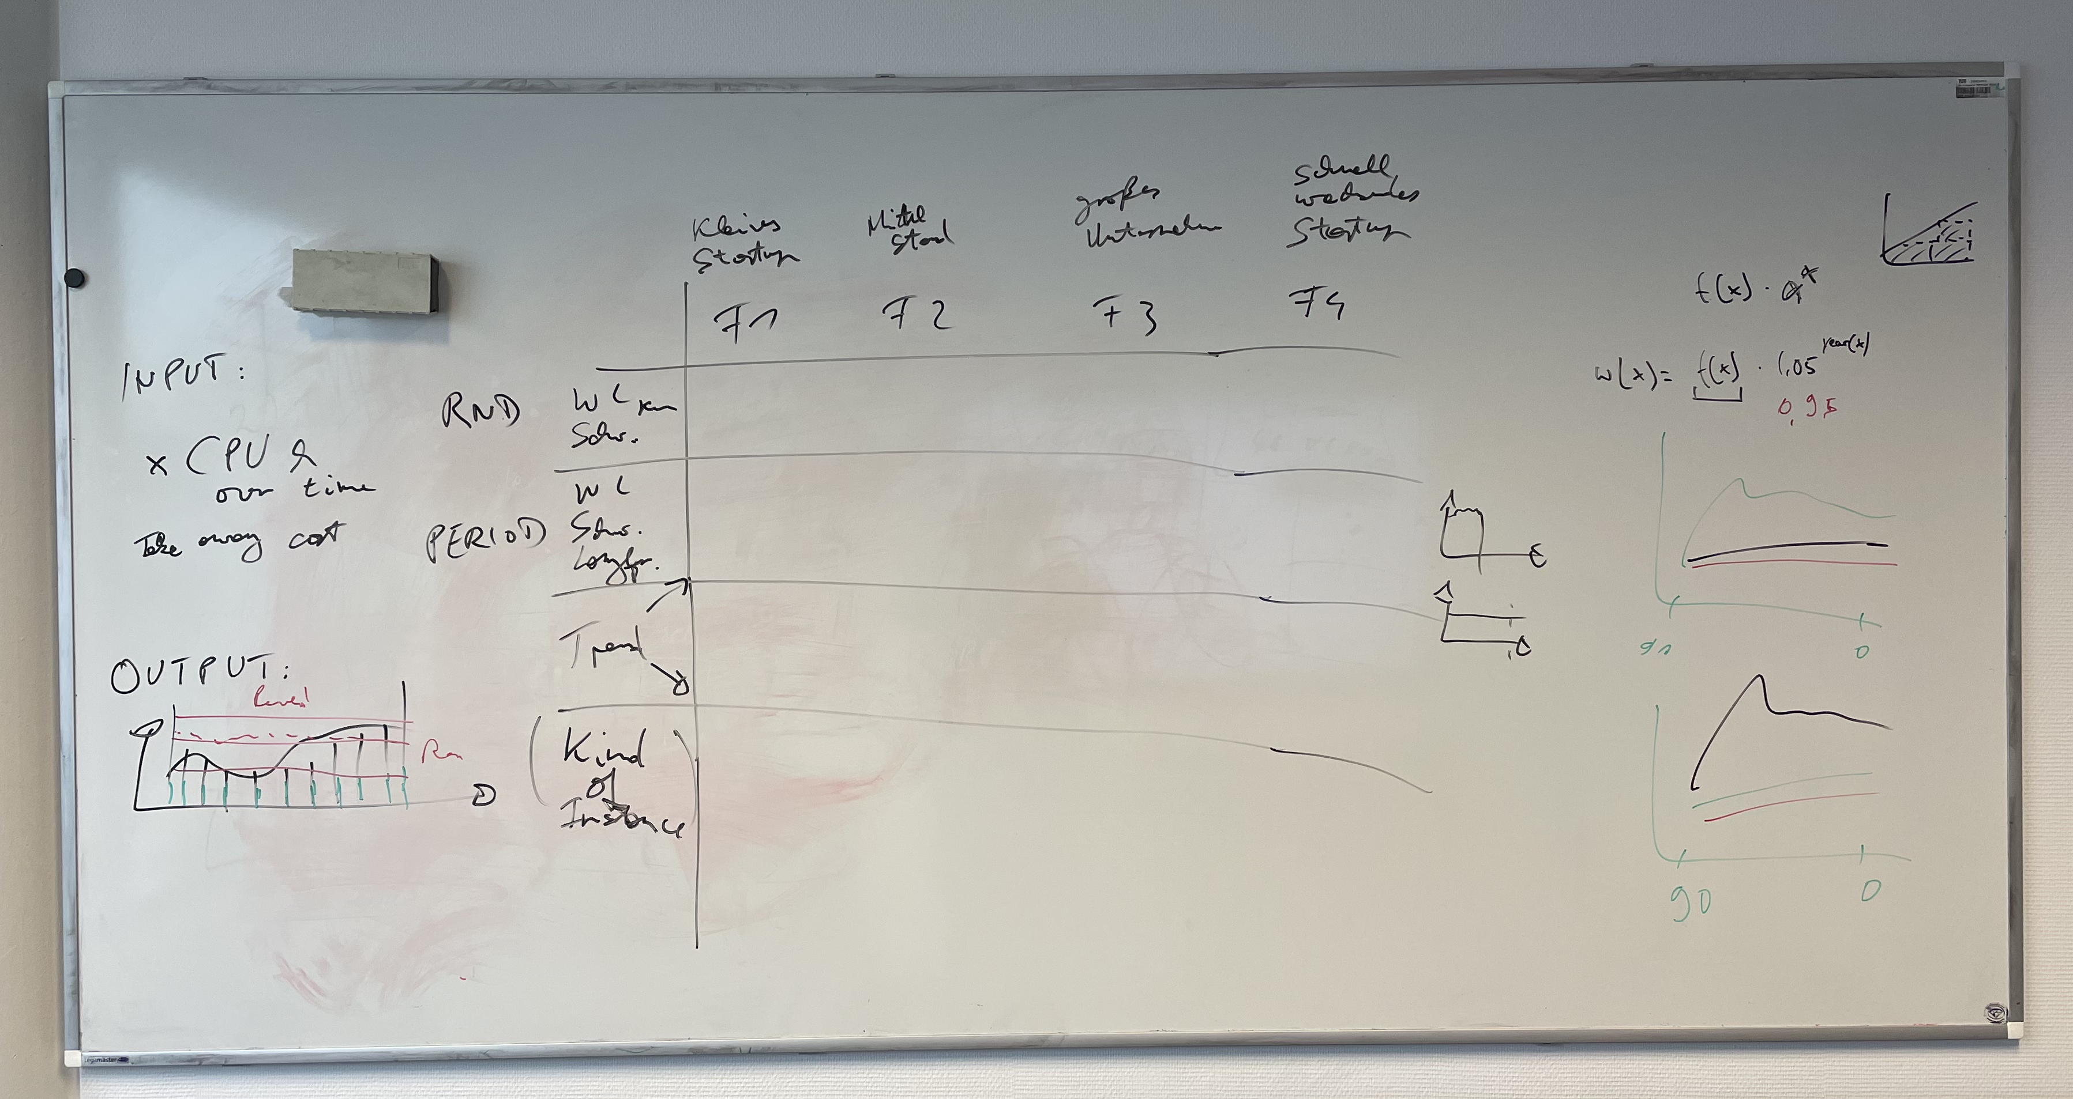

Slide 9
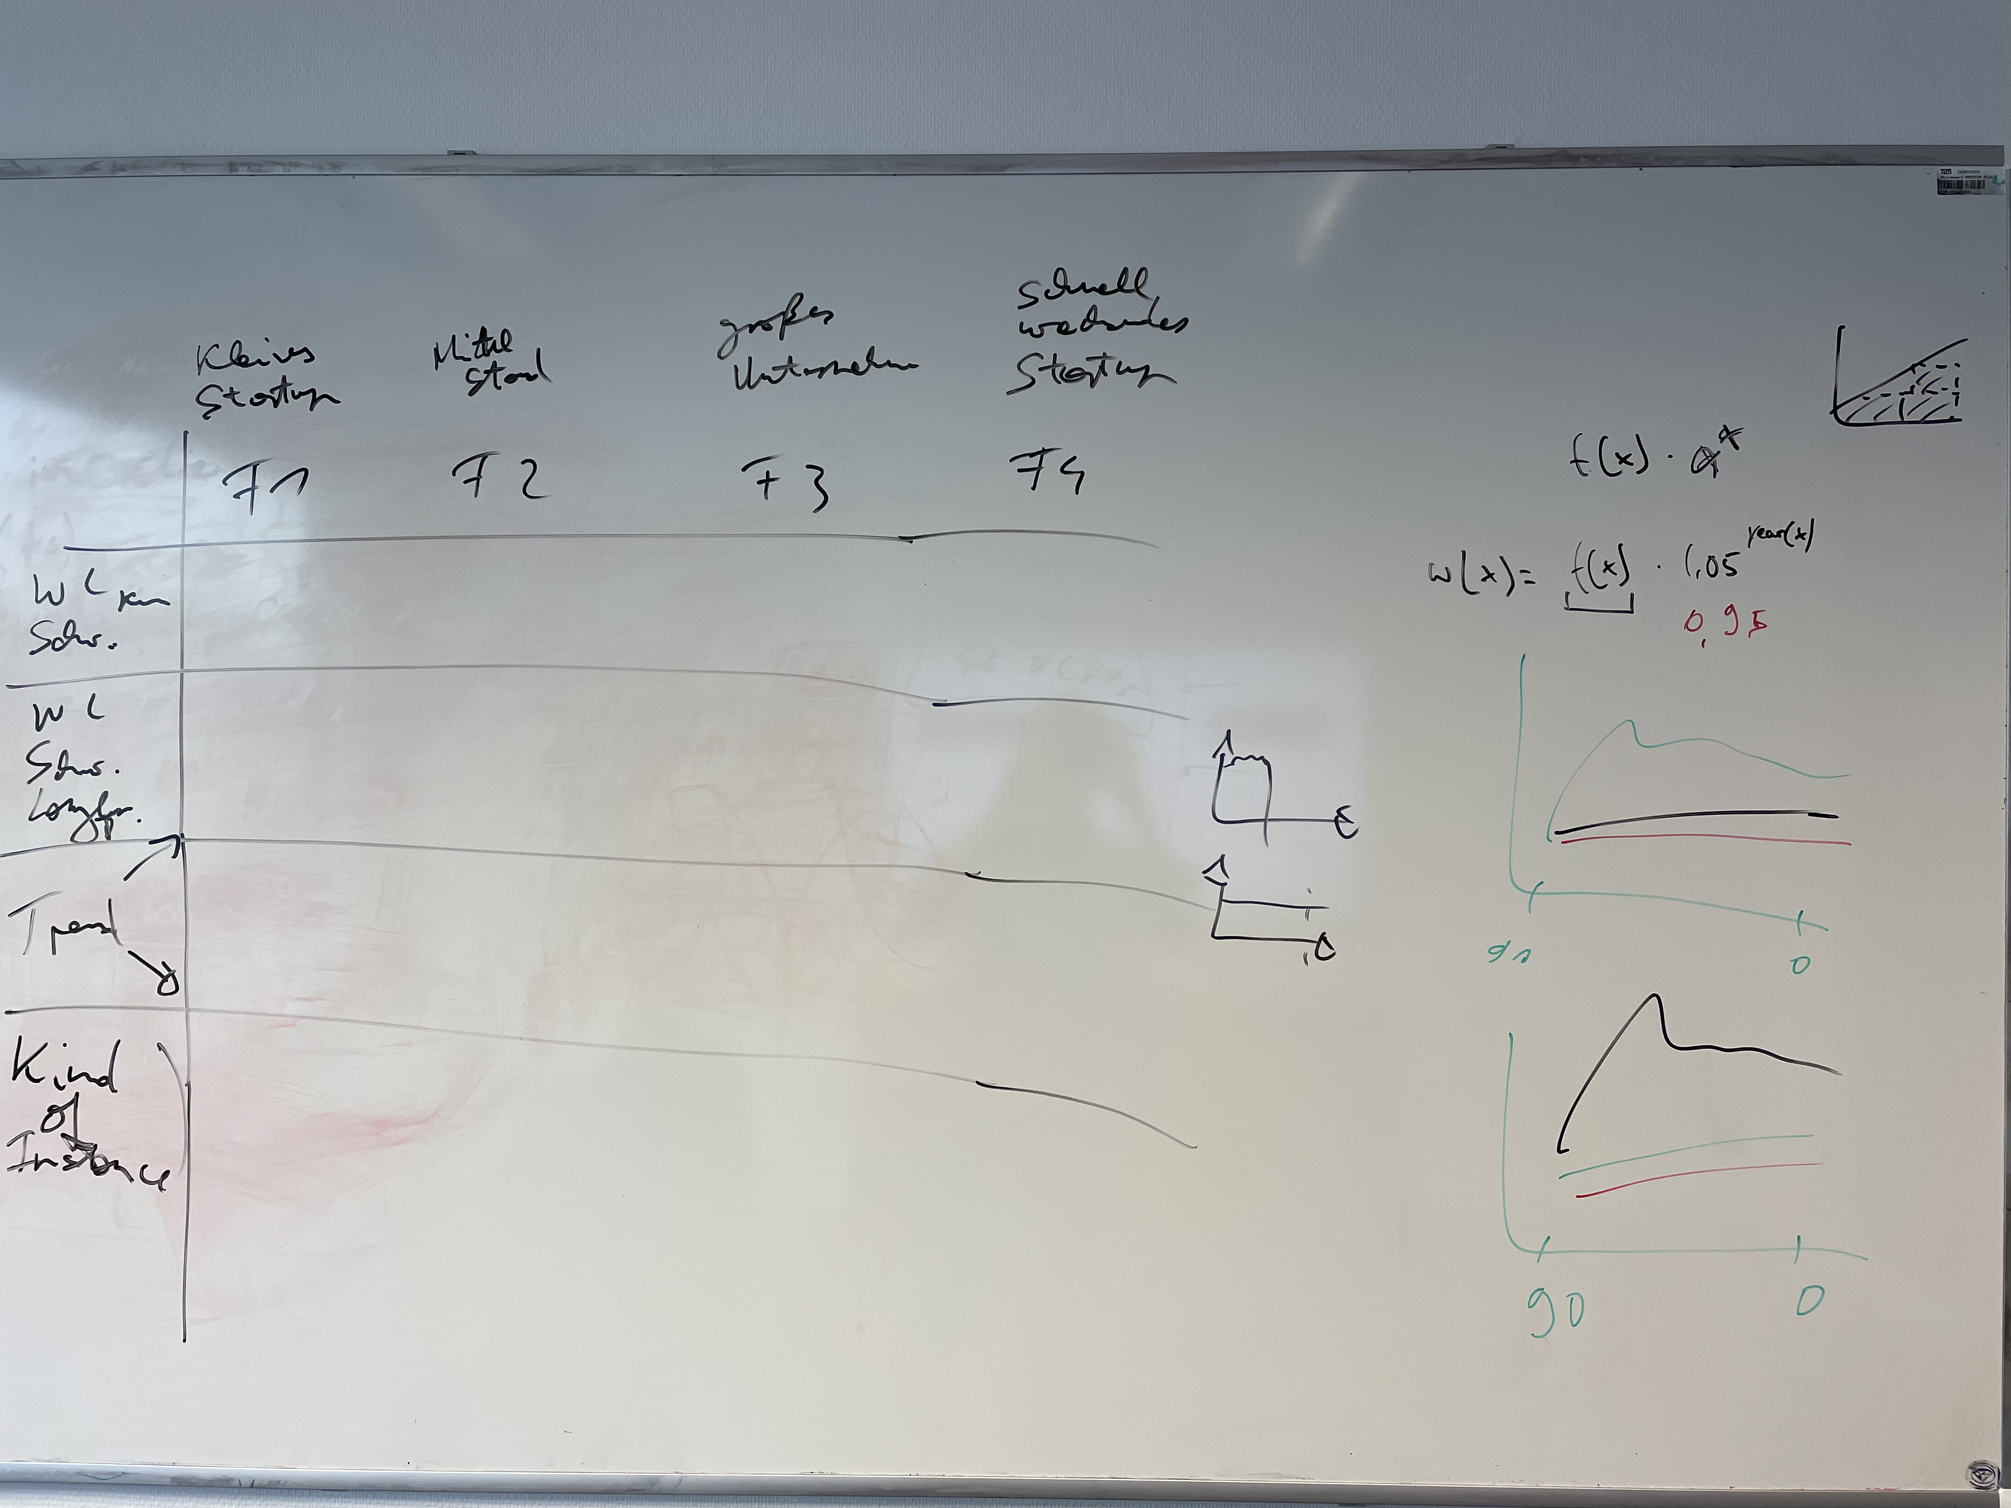
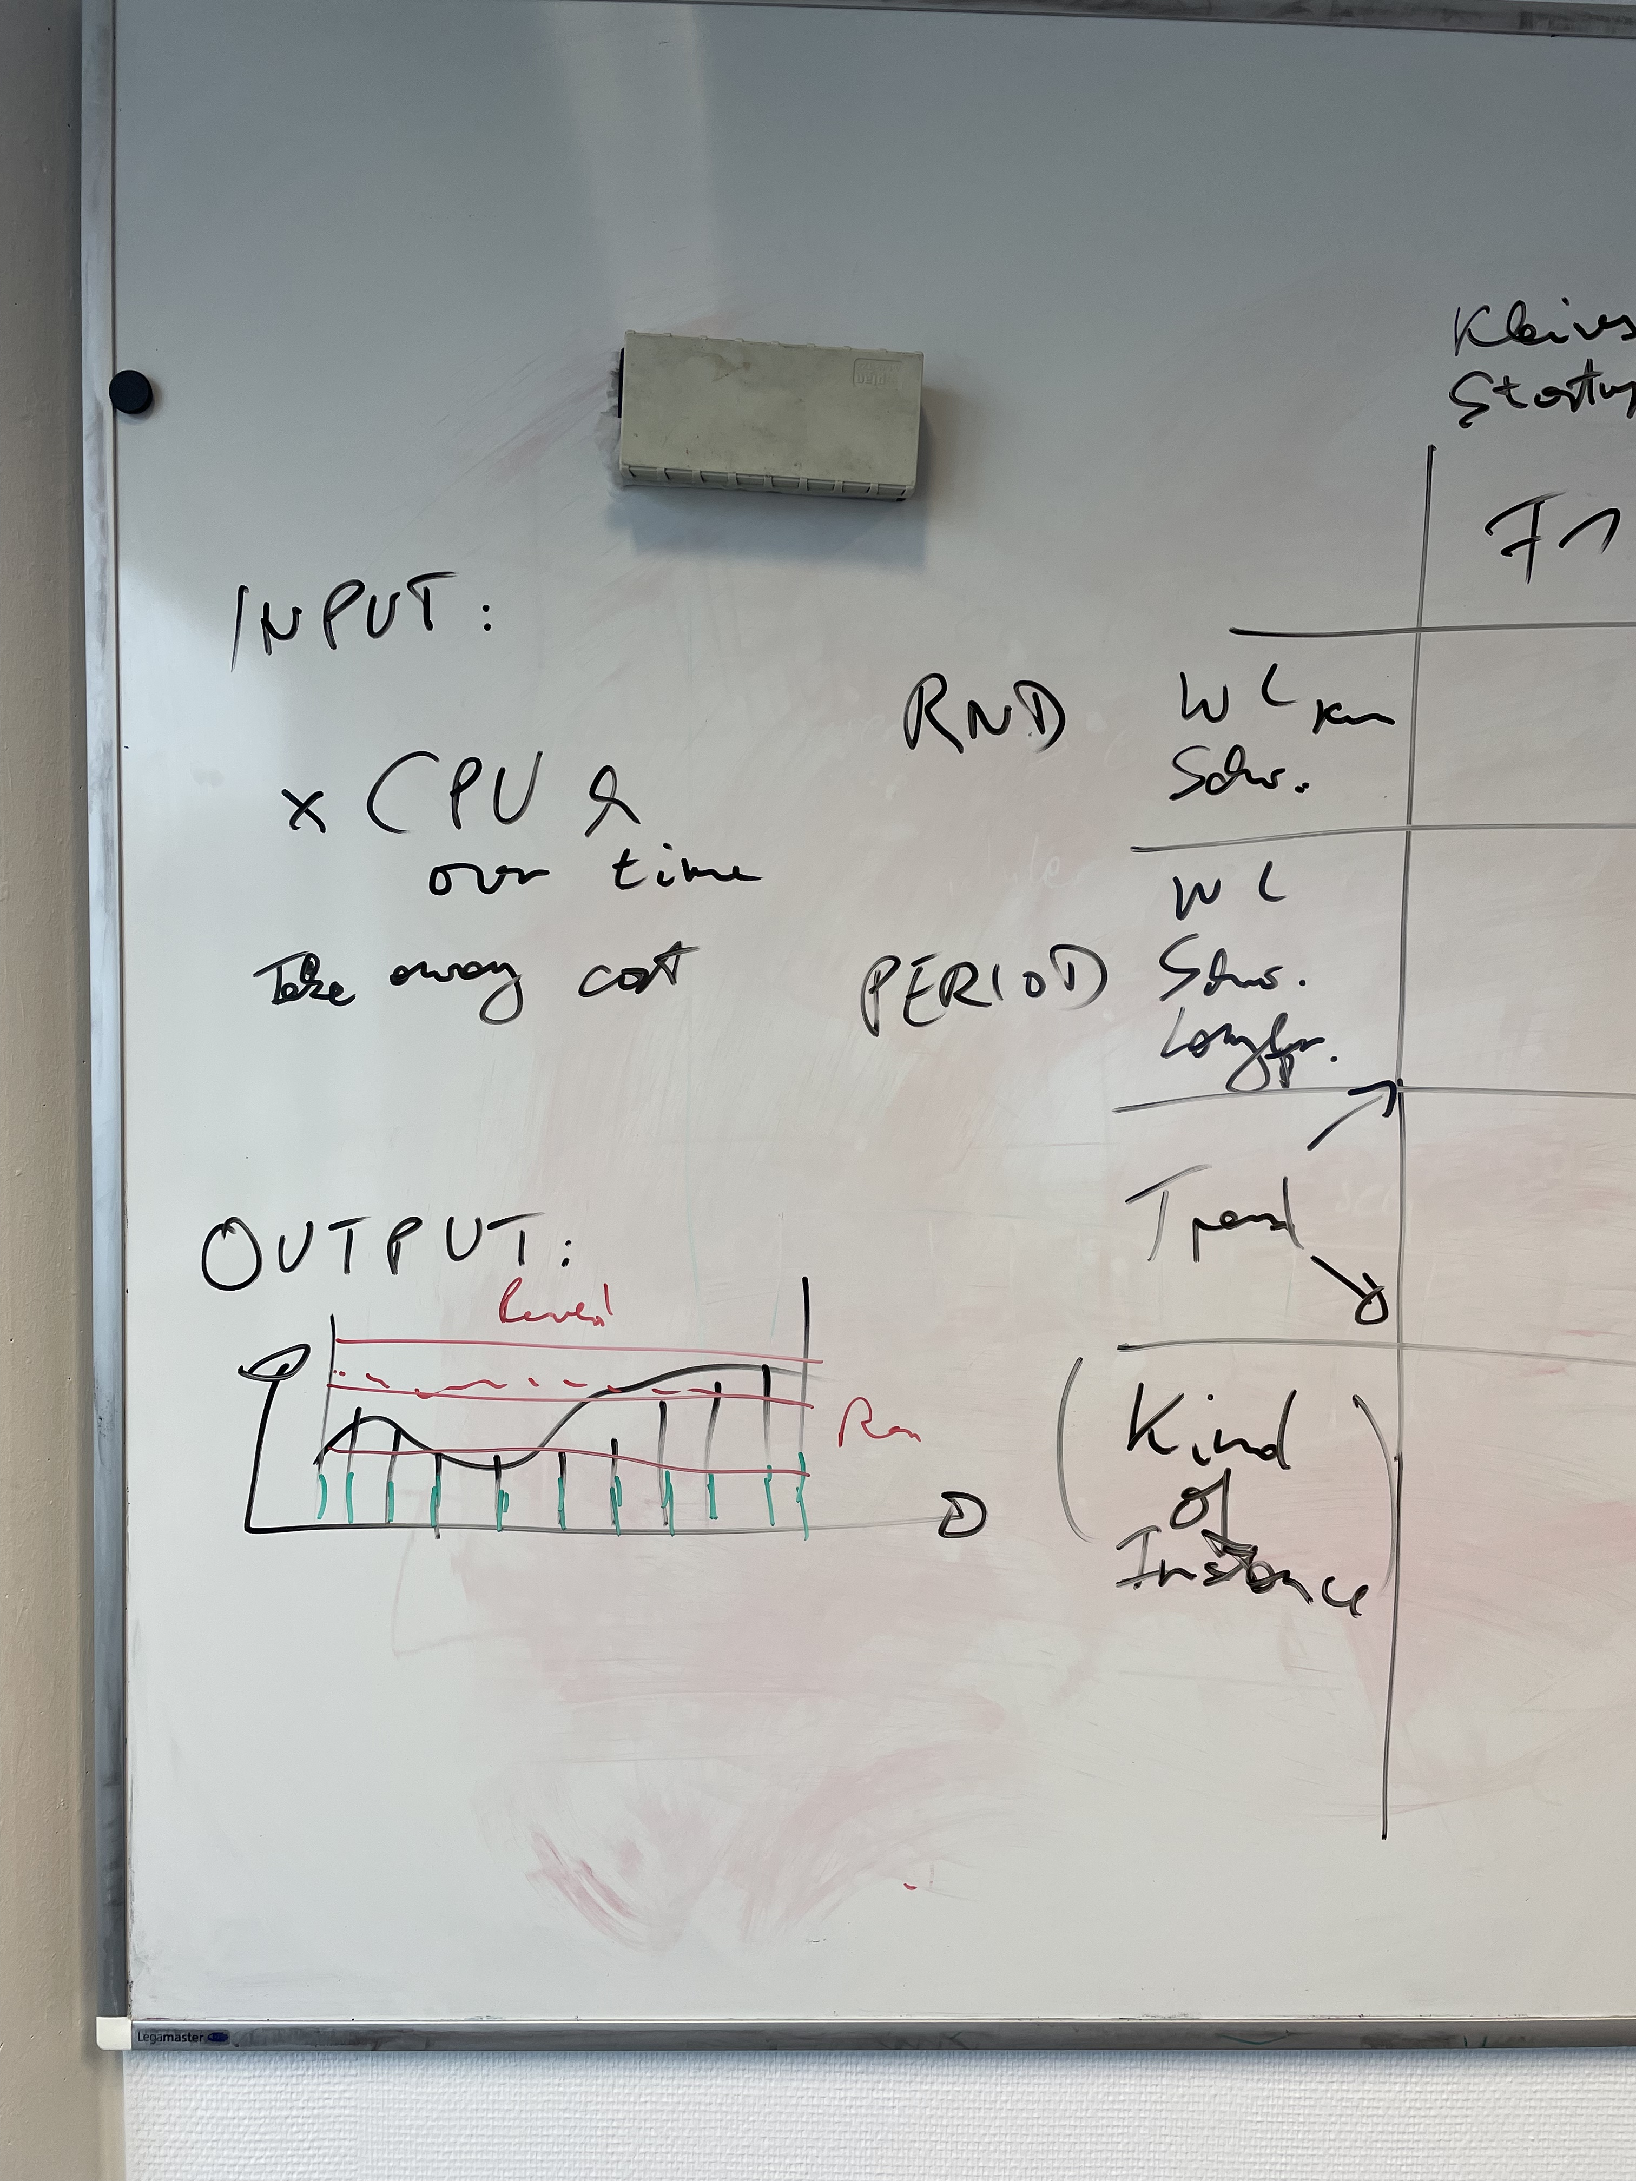

Slide 10
Identification of Relevant Parameters for an Algorithm
Hardware requirements = Eingabe:
Wie viele vCPUs werden mindestens benötigt?
Wie viel memory wird mindestens benötigt?
Welche Network performance wird mindestens benötigt?
Wie lange wird/werden die Instanz(en) benötigt?
Zusatz?
Was ist das übergeordnete Ziel (z.B. general purpose use cases vs. CPU optimized zur Auswahl der Instanzfamilie??)
Ist der workload fehlertolerant, etc. oder nicht, d.h. können Spot Instanzen verwendet werden?
Instanz + Preis = Ausgabe:
Welche Instanz in welcher Preisoption ist Preisoptimal für die gegebenen Parameter
Was muss der Algorithmus können:
Parameter als Input nehmen
On-demand Preise kennen
Wissen, bei welchen Voraussetzungen für Rabatte auf Savingsplans gelten
Auf Basis von historischen Daten Spotpreise mit einbeziehen
Monetäre Bewertung wenn Spot Instanz verloren geht (evtl. einfach auf nächst schlechtere switchen)
Memory und Network mit einberechnen

Slide 11
Welche Parameter spielen noch eine Rolle
IOPS
Storage
EBS / SSD

Slide 12
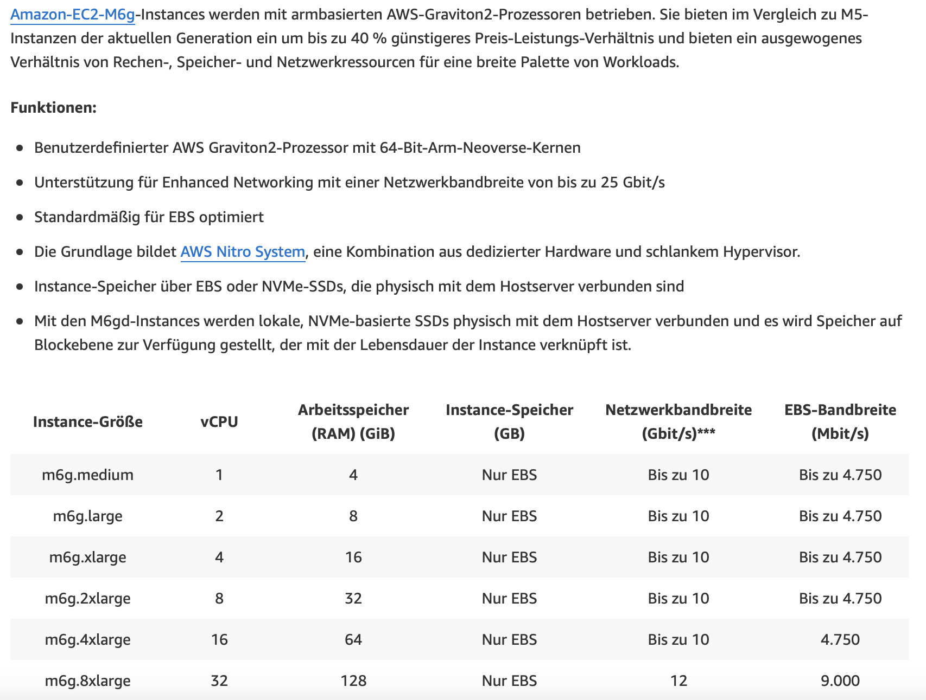
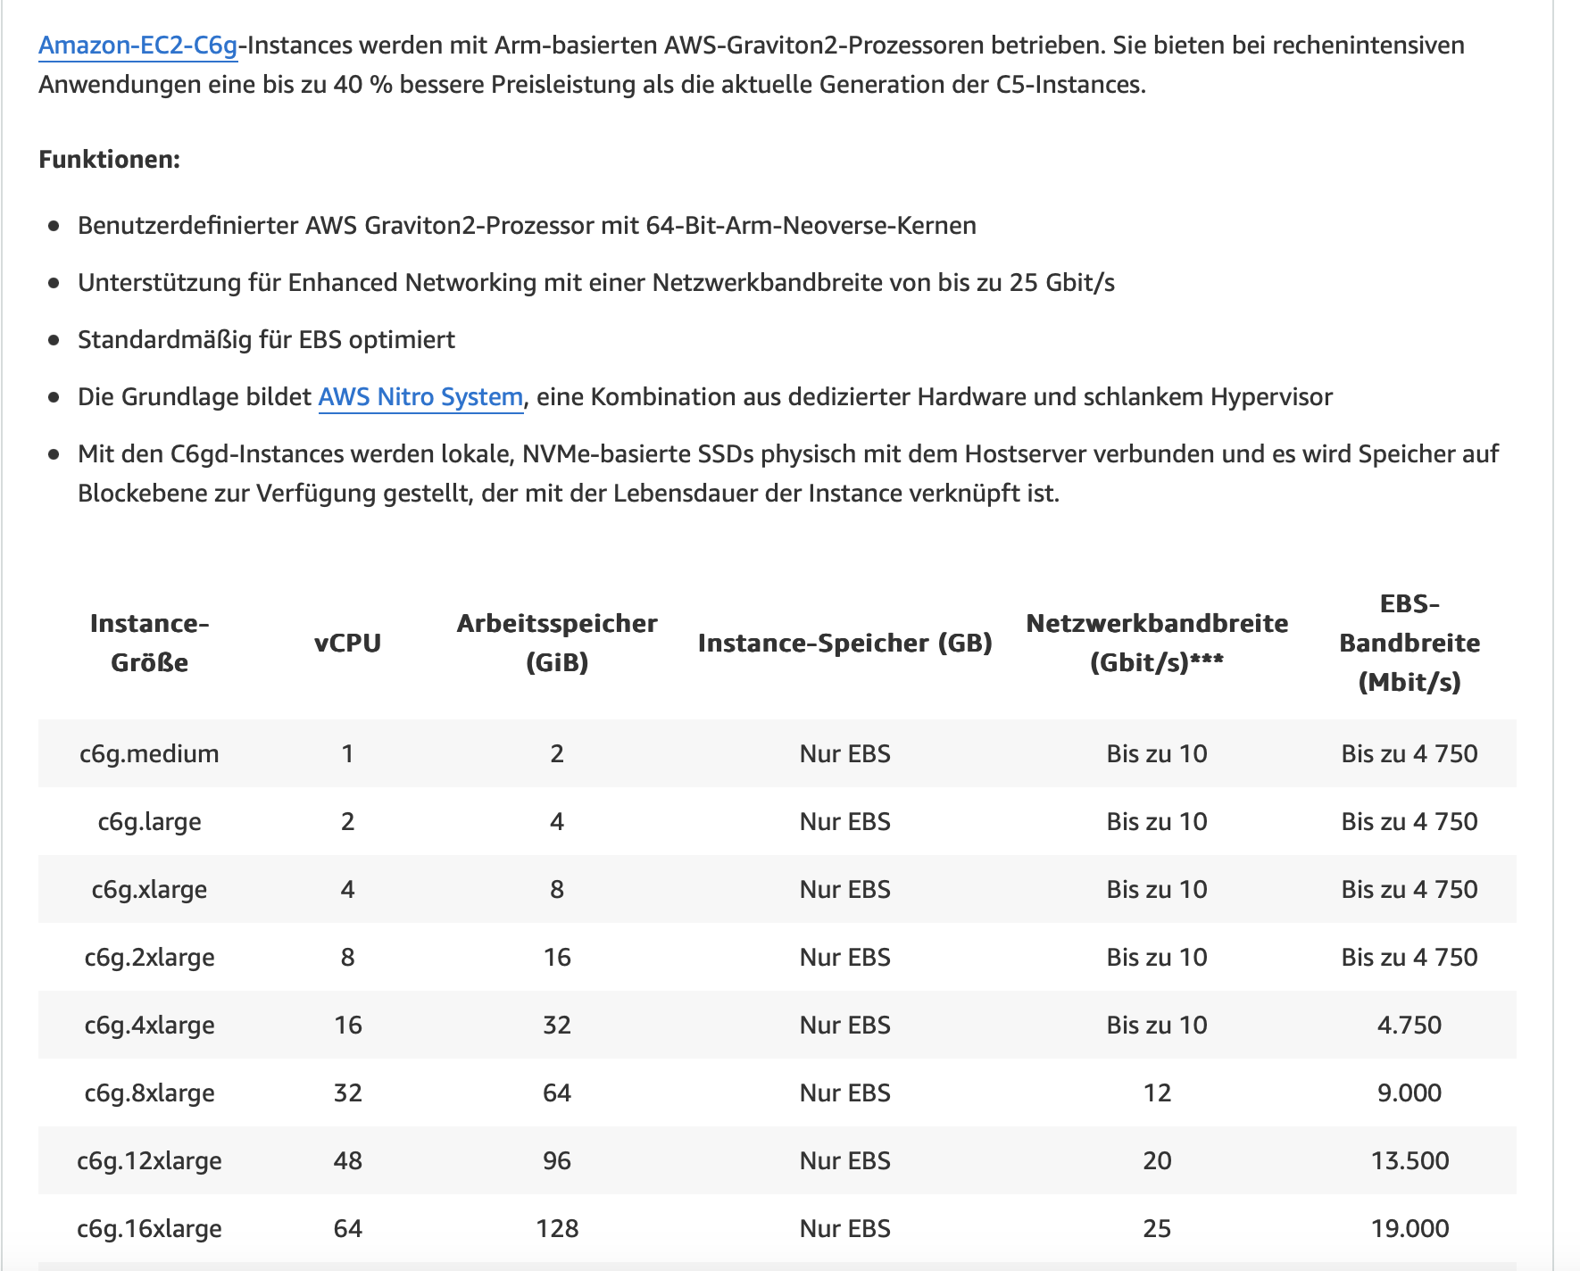
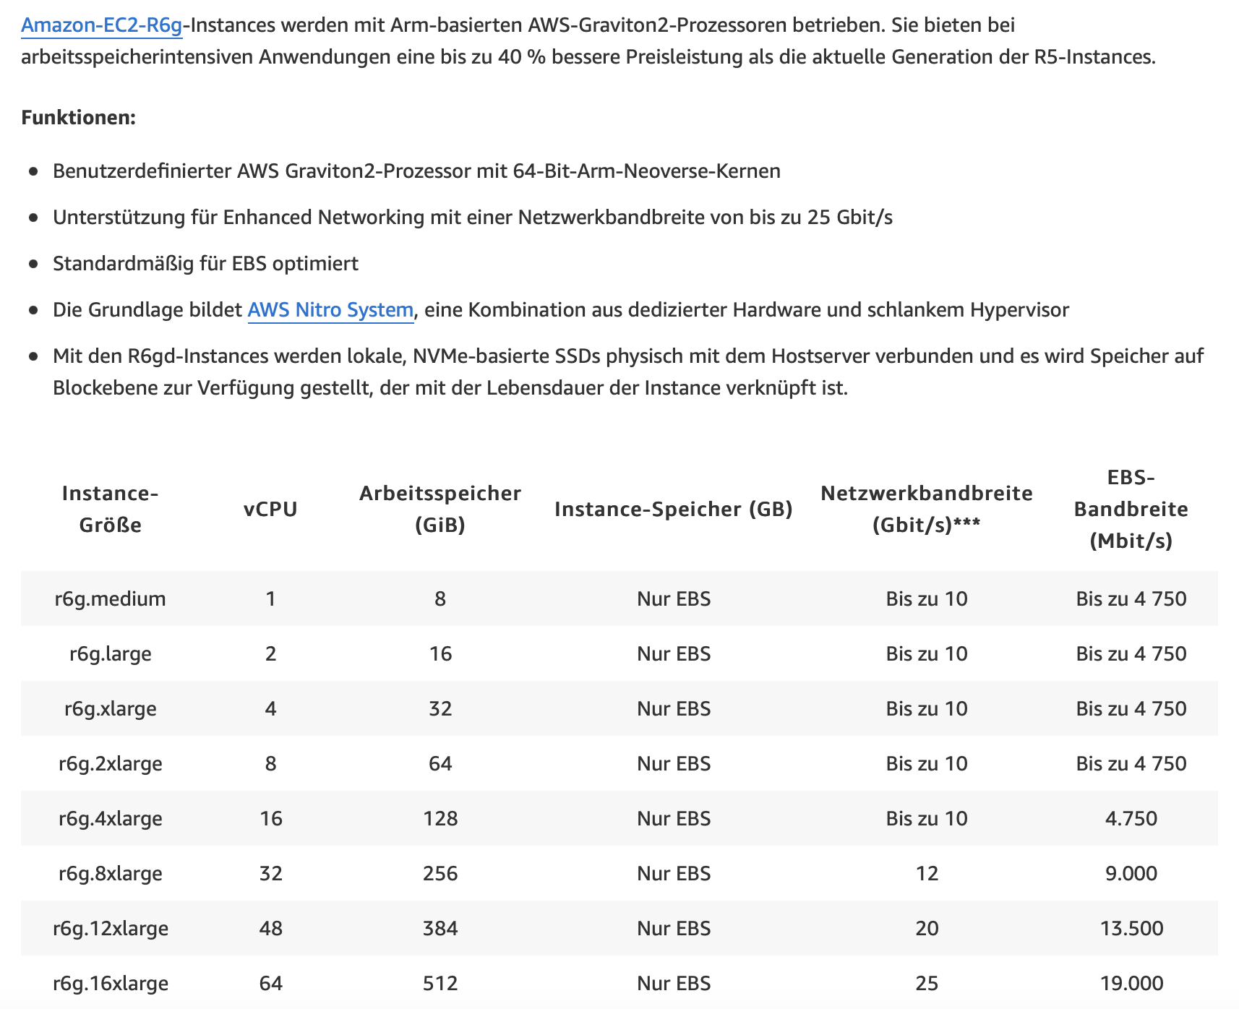
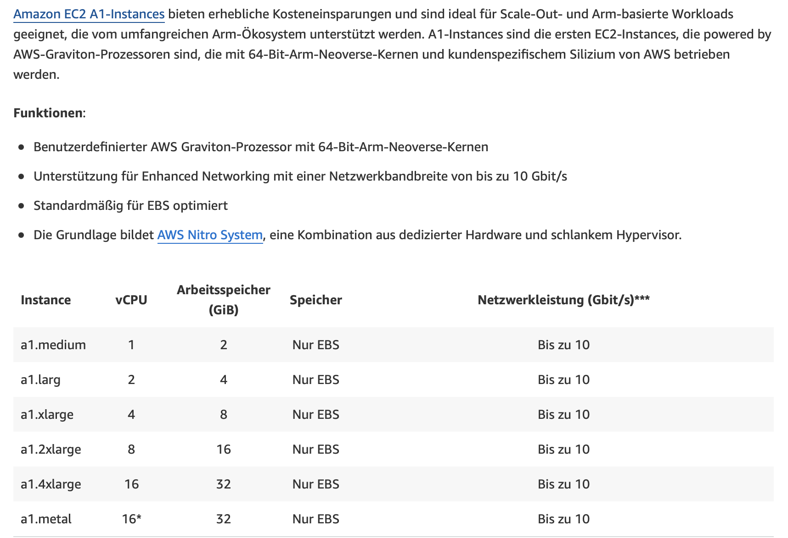
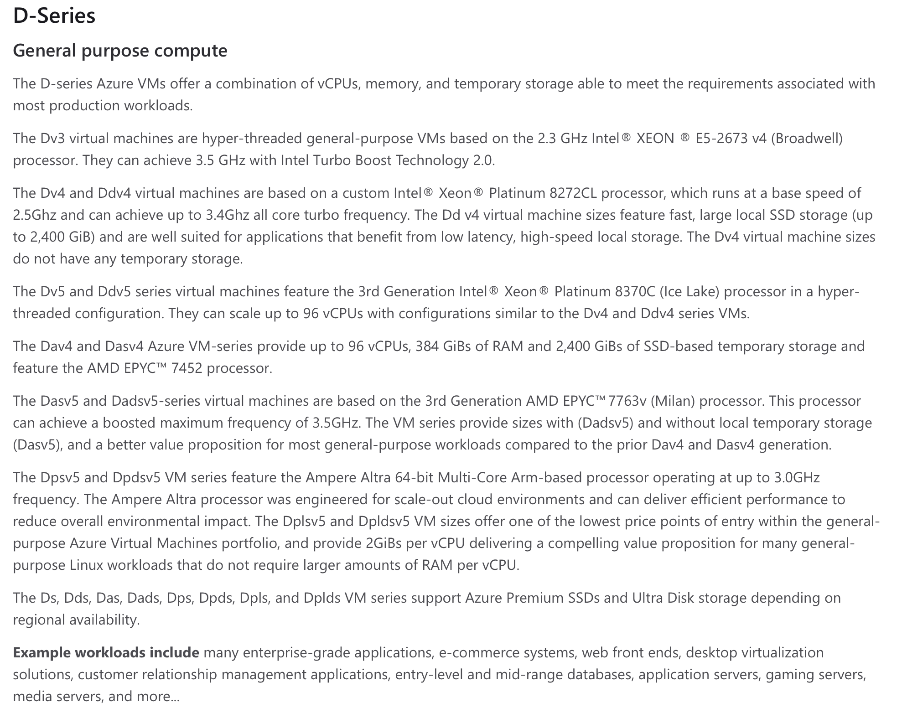
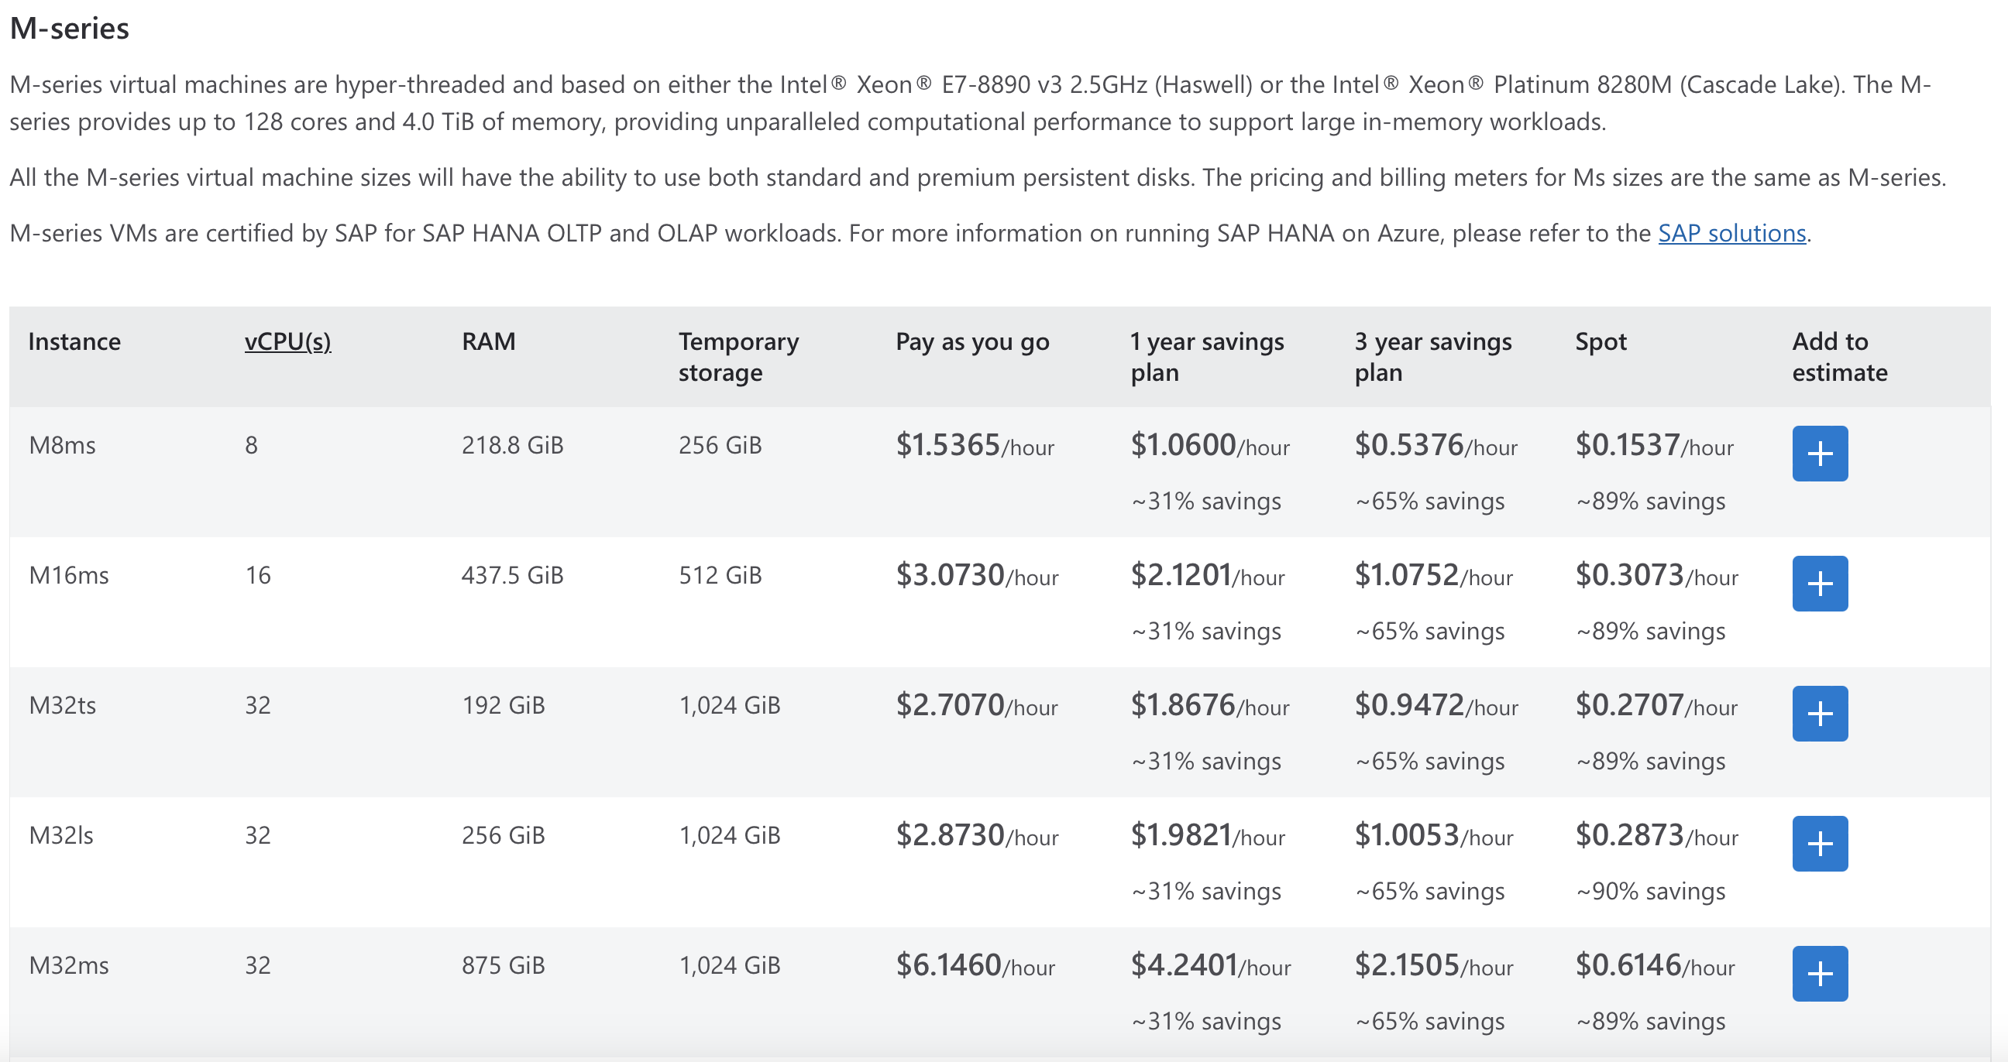
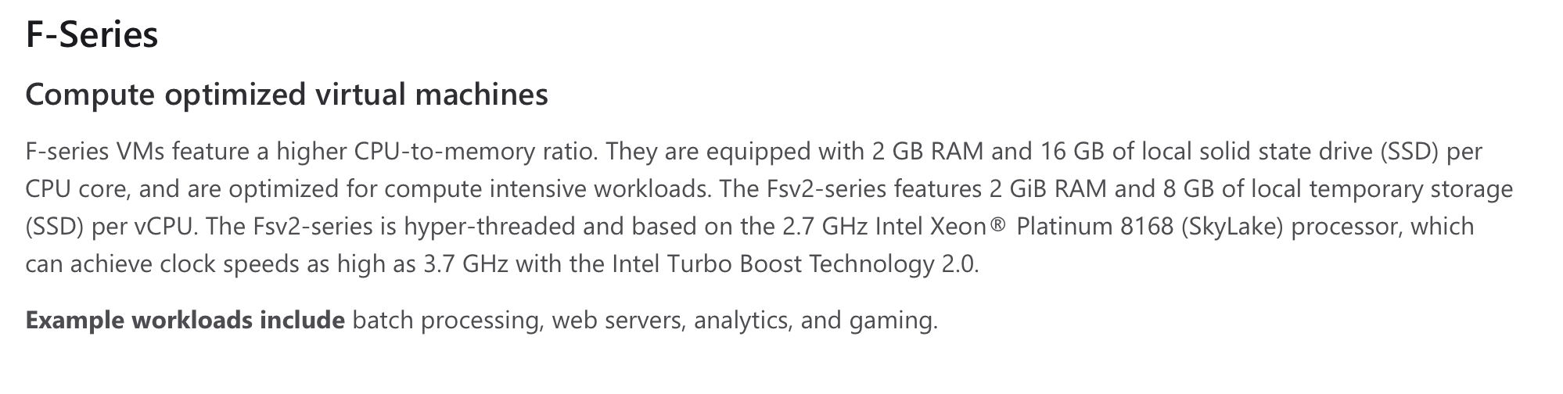
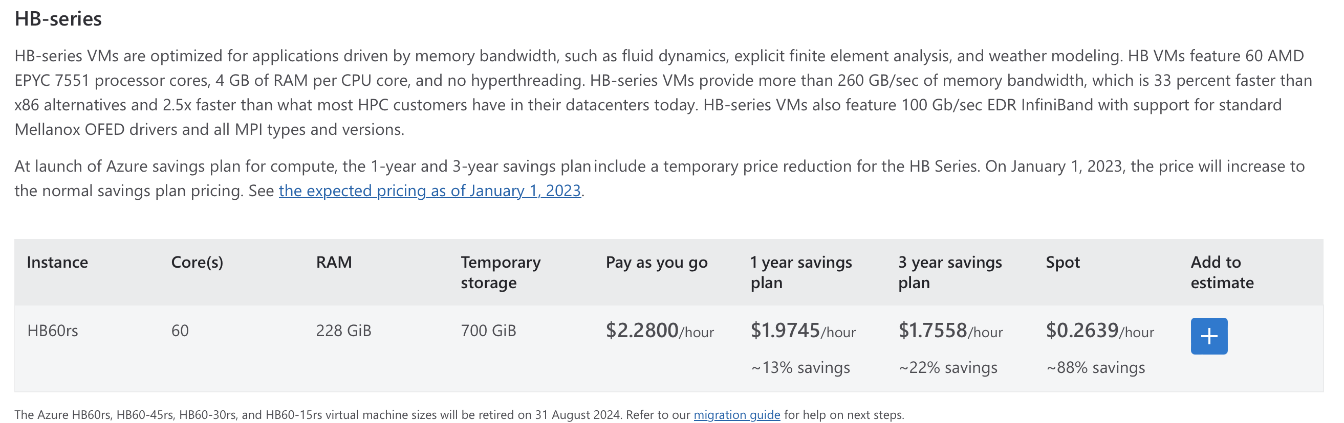
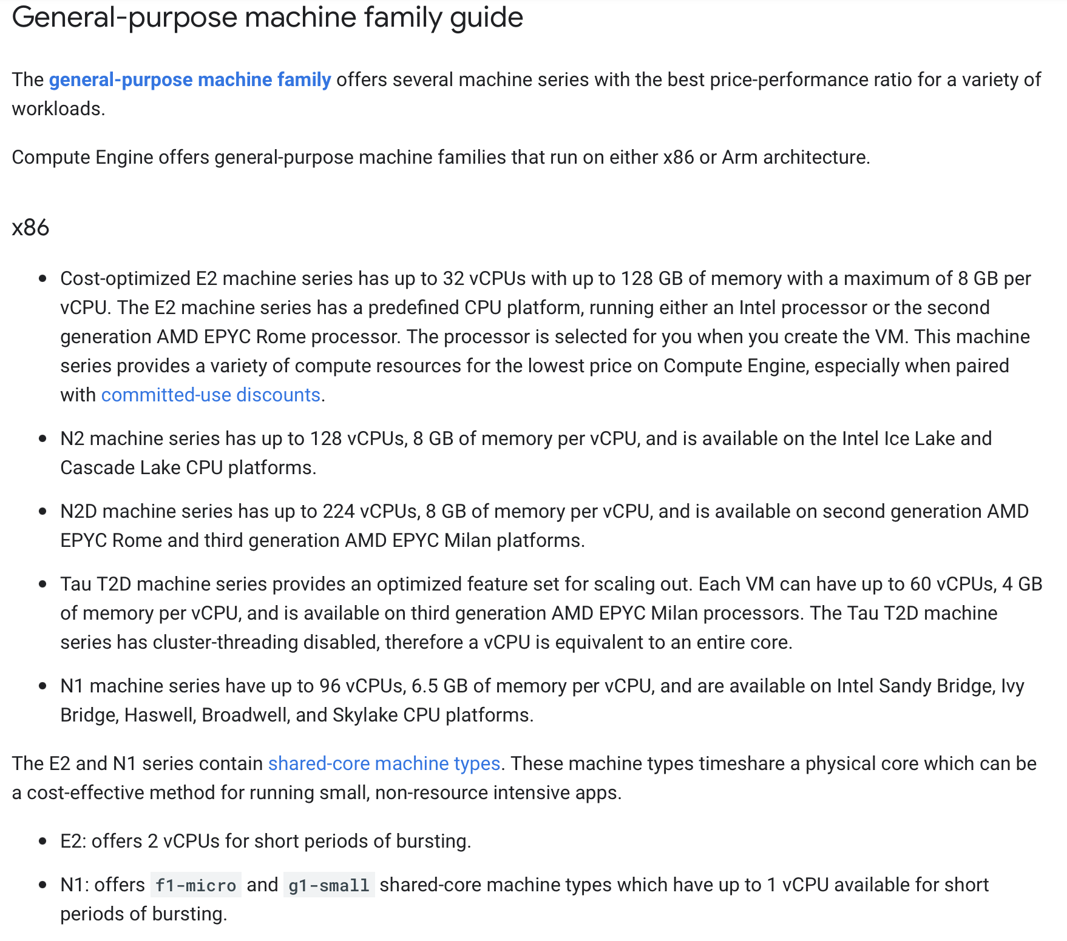
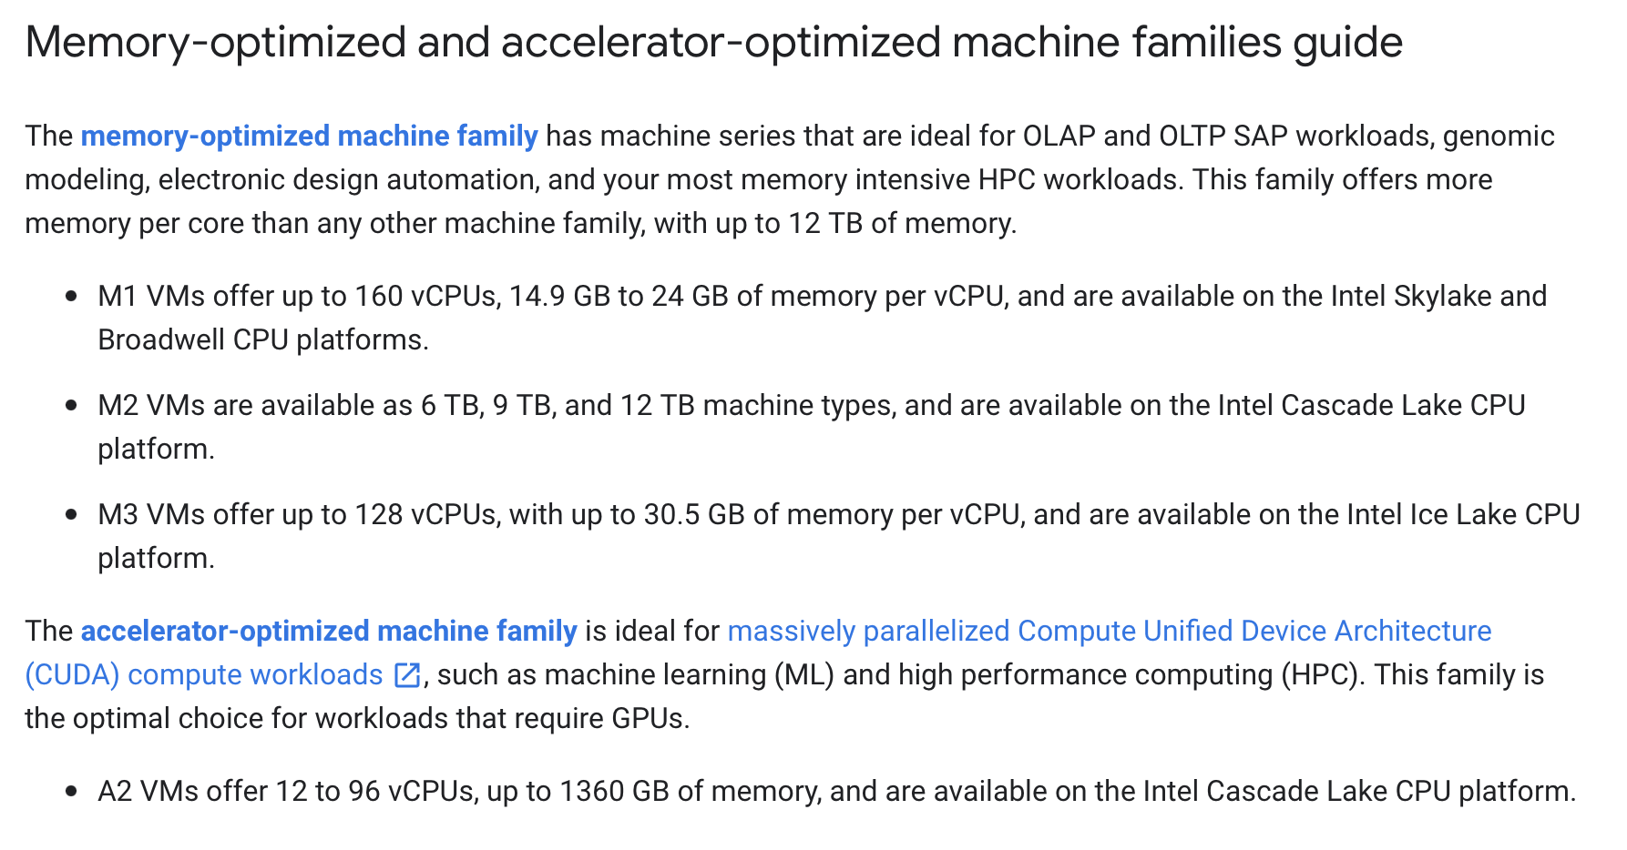
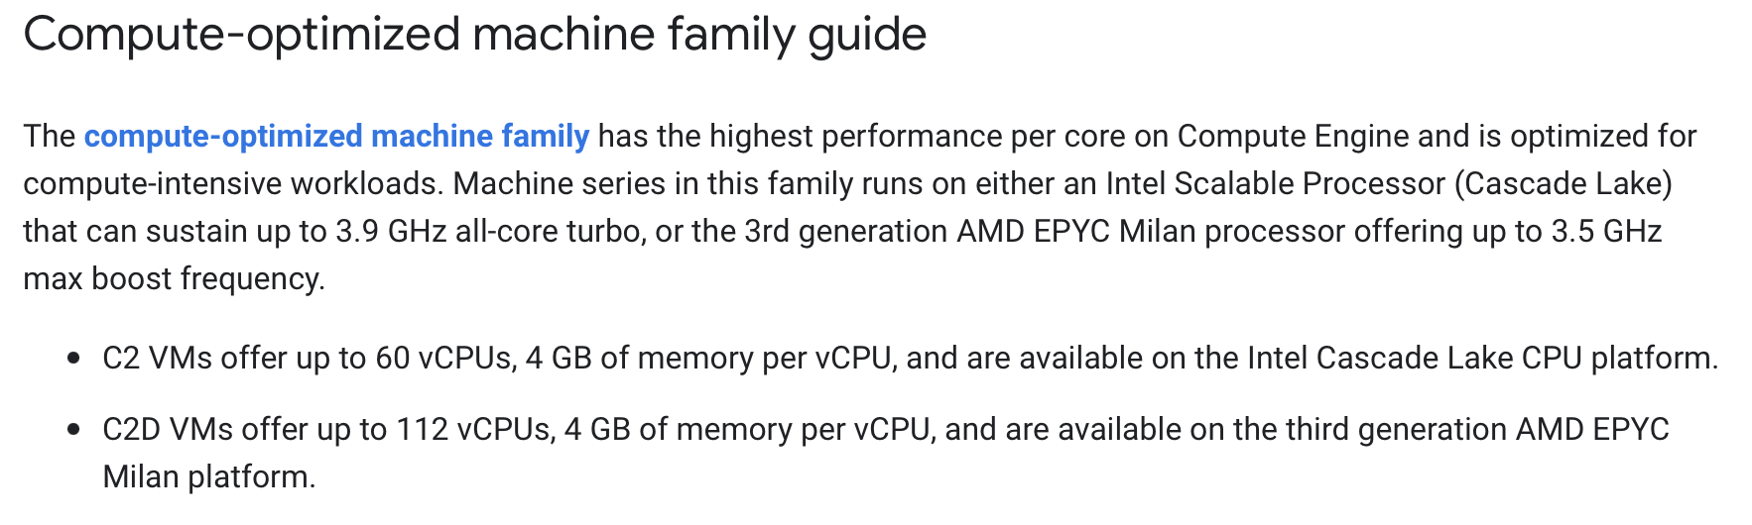
Information for instances with best vCPU/$ ratio
https://aws.amazon.com/de/ec2/instance-types/
https://azure.microsoft.com/en-us/pricing/details/virtual-machines/series/#pricing
https://cloud.google.com/compute/docs/machine-resource

Slide 13
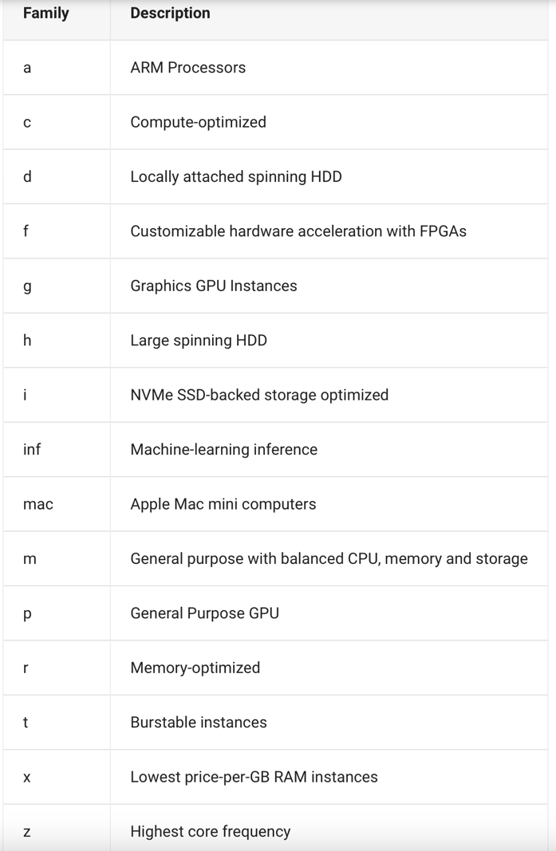
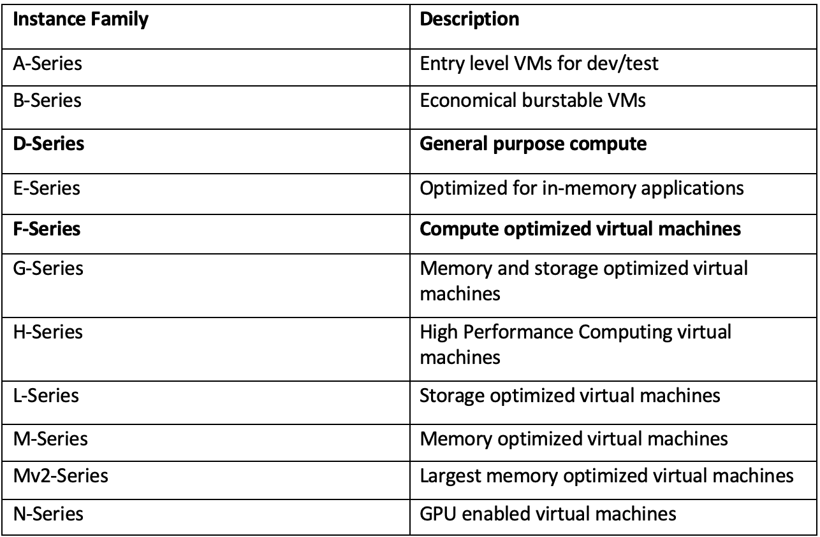
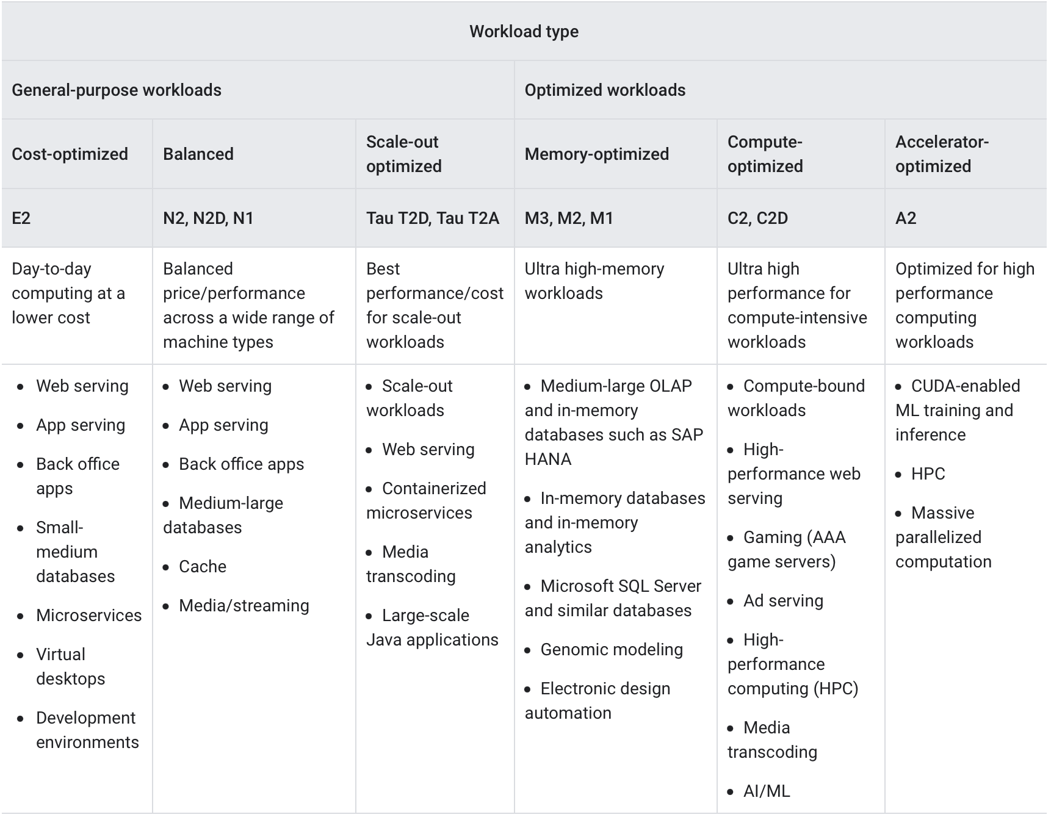
Overview of all instance families
AWS
Azure
GCP

